Slide 1
Introduction to JS - JavaScript
Instructor: Manu Peethambar
E-mail: cm13055@umbc.edu
Telegram handle: @manupeethambar888
Slides: https://github.com/manupeethambar888/webdev

Slide 2
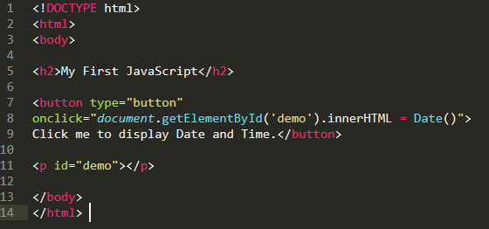
JavaScript
JavaScript is the programming language of HTML and the Web.
JavaScript is easy to learn.
JavaScript is case sensitive.
My First JavaScript:

Slide 3
Why Study JavaScript?
JavaScript is one of the 3 languages all web developers must learn:
HTML to define the content of web pages.
CSS to specify the layout of web pages.
JavaScript to program the behavior of web pages.
Web pages are not the only place where JavaScript is used. Many desktop and server programs use JavaScript.

Slide 4
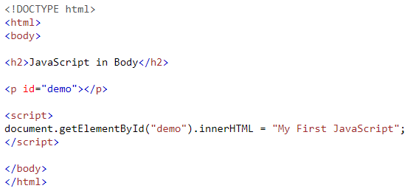
The <script> Tag
In HTML, JavaScript code must be inserted between <script> and </script> tags.

Slide 5
What can JavaScript do?
JavaScript Can Change HTML Content.
JavaScript Can Change HTML Attribute Values.
JavaScript Can Change HTML Styles (CSS).
JavaScript Can Hide HTML Elements.
JavaScript Can Show HTML Elements.
Practice: https://www.w3schools.com/js/js_intro.asp

Slide 6
JavaScript Functions and Events
A JavaScript function is a block of JavaScript code, that can be executed when "called" for.
For example, a function can be called when an event occurs, like when the user clicks a button.
JavaScript in <head> or <body>
You can place any number of scripts in an HTML document.
Scripts can be placed in the <body>, or in the <head> section of an HTML page, or in both.

Slide 7
JavaScript in <head> section
In this example, a JavaScript function is placed in the <head> section of an HTML page.
The function is invoked (called) when a button is clicked:
https://www.w3schools.com/js/tryit.asp?filename=tryjs_whereto_head
JavaScript in <body> section
In this example, a JavaScript function is placed in the <body> section of an HTML page.
The function is invoked (called) when a button is clicked:
https://www.w3schools.com/js/tryit.asp?filename=tryjs_whereto_body

Slide 8
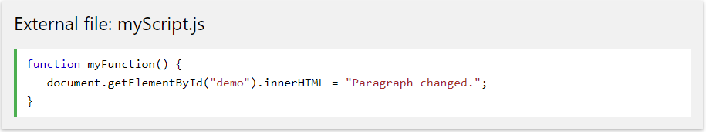

External JavaScript
Scripts can also be placed in external files:
External scripts are practical when the same code is used in many different web pages.
JavaScript files have the file extension .js.
To use an external script, put the name of the script file in the src (source) attribute of a <script> tag:

Slide 9
JavaScript Output
JavaScript can "display" data in different ways:
Writing into an HTML element, using innerHTML.
Writing into the HTML output using document.write().
Writing into an alert box, using window.alert().
Writing into the browser console, using console.log().

Slide 10




Using innerHTML
Using document.write()
Using console.log()
Using window.alert()

Slide 11
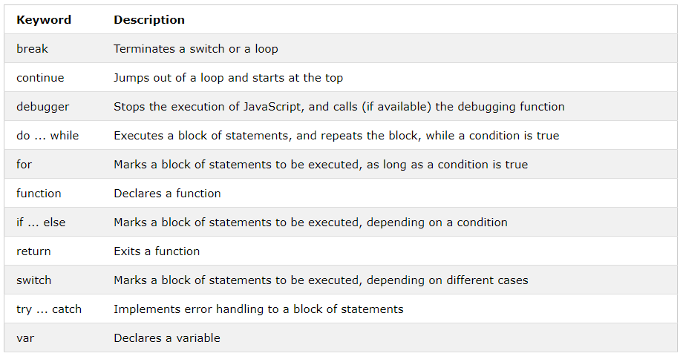
JavaScript Keywords

Slide 12
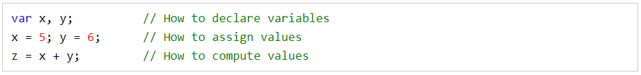
JavaScript Syntax
JavaScript syntax is the set of rules, how JavaScript programs are constructed:
Practice: https://www.w3schools.com/js/js_syntax.asp

Slide 13
JavaScript Variables
JavaScript variables are containers for storing data values.
Practice: https://www.w3schools.com/js/js_variables.asp
JavaScript Operators
Practice:
https://www.w3schools.com/js/js_operators.asp
https://www.w3schools.com/js/js_arithmetic.asp
https://www.w3schools.com/js/js_assignment.asp

Slide 14

JavaScript Data Types
JavaScript variables can hold many data types: numbers, strings, objects and more:
Practice: https://www.w3schools.com/js/js_datatypes.asp

Slide 15
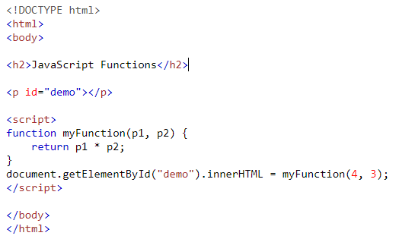
JavaScript Functions
A JavaScript function is a block of code designed to perform a particular task.
A JavaScript function is executed when "something" invokes it (calls it).
Practice: https://www.w3schools.com/js/js_functions.asp

Slide 16
Assignment 4 due – 6/27/2018 (today)
Create a sample html file.
Go to the next slide for the question.
Save this as “assignment4.html” in your GitHub repository “Assignments_yourname”.
Commit and push the changes to the repository.

Slide 17
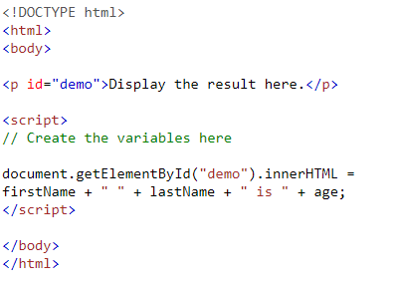
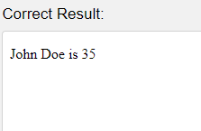
Assignment 4 due – 6/27/2018 (today)
Use a single var keyword to create three variables with the following values: firstName = "John" lastName = "Doe" age = 35

